Slide 1
UNIT - 1
Introduction to MS Excel
Part-1

Slide 2
Introduction to MS Excel
Microsoft Excel is a computer application program written by Microsoft. It mainly comprises tabs, groups of commands, and worksheets. It stores the data in tabular form and allows the users to perform manipulation operations on them.
Microsoft Excel is an office use application designed by Microsoft. It comes with Office Suite with several other Microsoft applications, such as Word, Powerpoint, Access, Outlook, and OneNote, etc. It is supported in Windows as well as Mac operating system too.

Slide 3
Microsoft Excel is one of the most suitable spreadsheet programs that help us to store and represent the data in tabular form, manage and manipulate data, create optically logical charts, and more. Excel provides you the worksheet to create a new document in it. You can save the Excel file with .xls extension.

Slide 4
Worksheet
A worksheet is made of rows and columns that intersect each other to form cells where data is entered. It is capable of performing multiple tasks like calculations, data analysis, and integrating data.
In Excel worksheet, rows are represented by numbers and columns by alphabets.
A single Excel workbook can consist of several sheets, named Sheet1, Sheet2, Sheet3… SheetN. You can add one or more sheets to your Excel document.

Slide 5
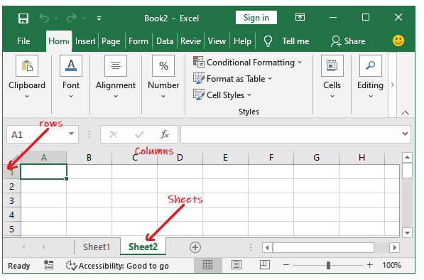

Slide 6
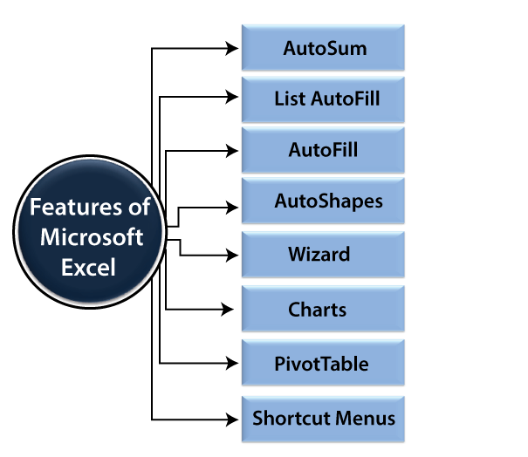
Features of MS Excel

Slide 7
AutoFormat: It allows the Excel users to use predefined table formatting options.
AutoSum: AutoSum feature helps us to calculate the sum of a row or column automatically by inserting an addition formula for a range of cells.
List AutoFill: It automatically develops cell formatting when a new component is added to the end of a list.

Slide 8
AutoFill: This feature allows us to quickly fill cells with a repetitive or sequential record such as chronological dates or numbers and repeated documents. AutoFill can also be used to copy functions. We can also alter text and numbers with this feature.
AutoShapes: AutoShapes toolbar will allow us to draw some geometrical shapes, arrows, flowchart items, stars, and more. With these shapes, we can draw our graphs.
Wizard: It guides us to work effectively while we work by displaying several helpful tips and techniques based on what we are doing. Drag and Drop feature will help us to reposition the record and text by simply dragging the data with the help of the mouse.

Slide 9
Charts: This feature will help you to present the data in graphical form by using Pie, Bar, Line charts, and more.
PivotTable: It flips and sums data in seconds and allows us to execute data analysis and generating documents like periodic financial statements, statistical documents, etc. We can also analyze complex data relationships graphically.
Shortcut Menus: The shortcut menu helps users to make the work done through shortcut commands that need a lengthy process.

Slide 10
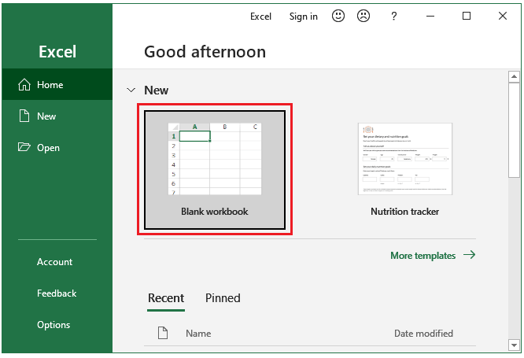
Opening a new workbook

Slide 11
Opening a blank workbook automatically
Click File then Options (Inside the More… in the right panel).
On the General tab, scroll down and go to the Start up options.
Here, uncheck the Shows the Start screen when this program starts checkbox and then click OK.

Slide 12
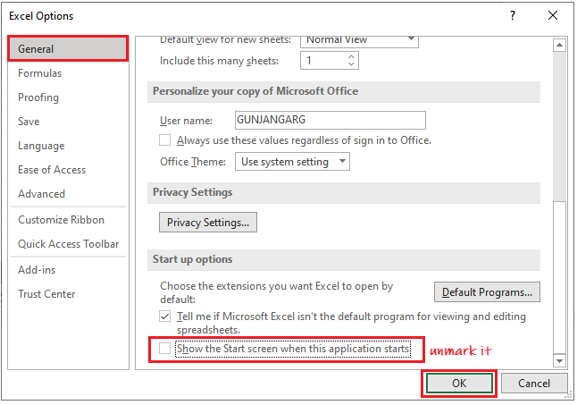

Slide 13
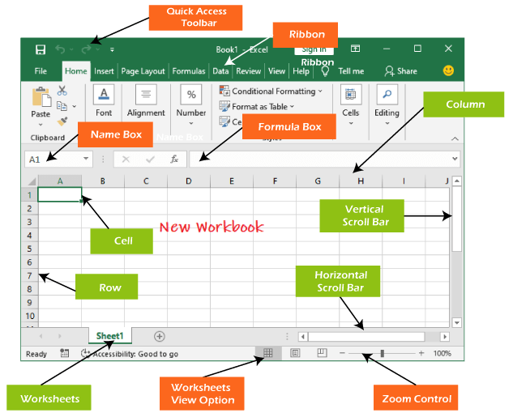
Excel Interface

Slide 14
Quick Access Toolbar
The Quick Access Toolbar contains some common and most used commands of Excel, which users repeatedly need while working with Excel. By default, Save, Undo, and Repeat commands are added in the quick access toolbar.
It provides fast access to its users by adding most-used commands in it. This quick access toolbar is customizable. It means you can add other commands, whichever you need most.

Slide 15
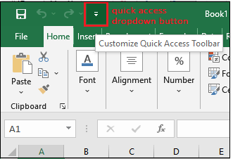

Slide 16
Ribbon
Excel 2016 utilizes a tabbed Ribbon system instead of traditional menus. The Ribbon includes multiple tabs, each with several groups of commands.
File, Home, Insert, Page Layout, Formula, Data, Review, View, and Help are the tabs consists by the Excel ribbon.

Slide 17
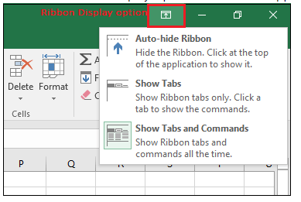
Minimize and maximize ribbon

Slide 18
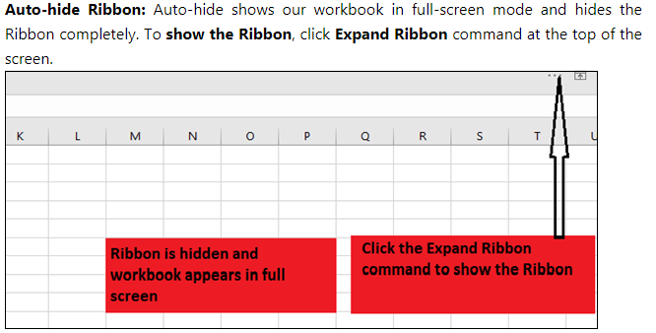

Slide 19
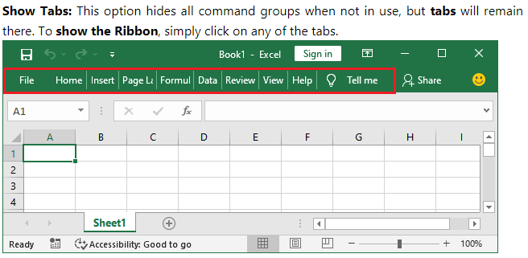

Slide 20
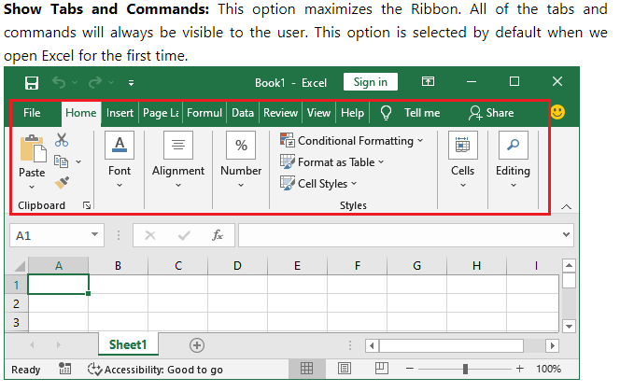

Slide 21
Customizing Ribbon
Right-click the Ribbon and then choose Customize the Ribbon from the drop-down menu.
The Excel Optionsdialog box will occur. Locate and select New Tab or New group, whichever you want to add.
Now, select a command from the left panel and click the Add button to the new customized tab/group. You can also drag the commands directly into a group.

Slide 22
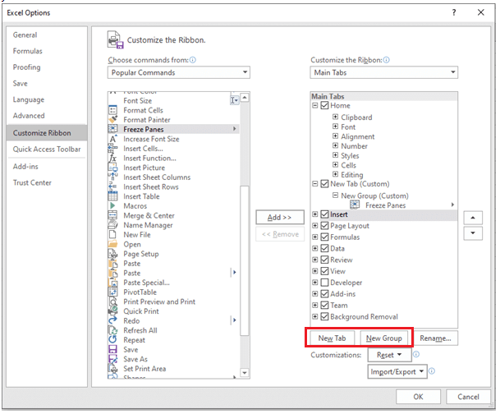

Slide 23
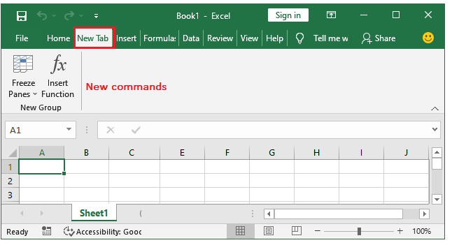

Slide 24
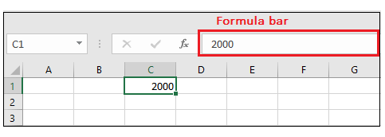
Formula Bar
In the formula bar, we can enter or edit data, a formula, or a function that will occur in a specific cell. It allows to write the function and formulas to manipulate the data.

Slide 25
Name Box
The Name box presents the location or "name" of a selected cell.
In the image, cell B4 is selected. Noted that cell B4 is where column B and row 4 intersect.

Slide 26
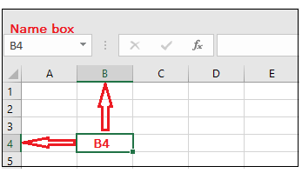

Slide 27
Worksheet View Option
Excel 2016 has a variety of displaying options that change how our workbook is showed. We can choose to view any workbook in the Normal view, Page Layout view, or Page Break view. These views can be useful for several tasks, especially if we're planning to print the spreadsheet.
To change the worksheet views, locate and choose the desired worksheet view command in the bottom-right corner of the Excel window.

Slide 28
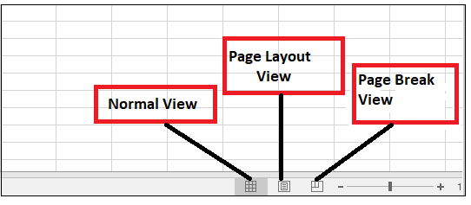

Slide 29
Zoom Control
To use a Zoom control, click and drag the slider. The number to the right of the slider reverse the zoom percentage. It presents at the bottom right corner of the Excel worksheet.

Slide 30
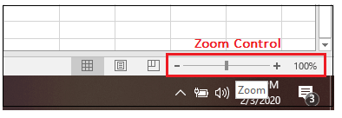

Slide 31
Workbook
An Excel workbook is a collection of worksheets that stores the data inside rows and columns. A new Excel workbook is default named as Book1.
A single Excel worksheet consists of around 1,048,576 and 16,384 columns.
A workbook has several worksheets, named as Sheet1, Sheet2, Sheet3, … SheetN.
One worksheet can be active at a time.

Slide 32
Worksheet
Whenever we create a new Excel workbook, it will include one worksheet named Sheet1.
A worksheet is a framework of columns and rows where columns are identified by letters running across the top of worksheet, and rows are identified by numbers running down the left side of the worksheet.

Slide 33
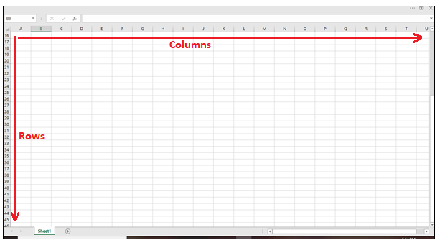

Slide 34
Operations on Worksheets
To rename a worksheet
To insert a new worksheet
To delete a worksheet
To copy a worksheet
Copy a worksheet to another workbook
To move a worksheet
To change the worksheet color

Slide 35
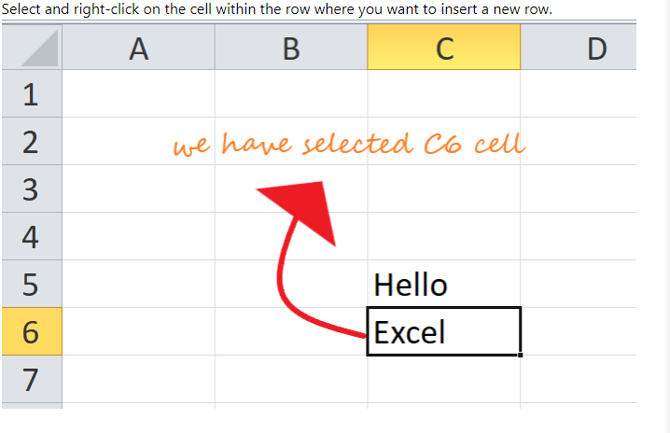
Insert a Row in Excel

Slide 36
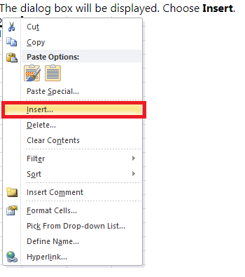

Slide 37
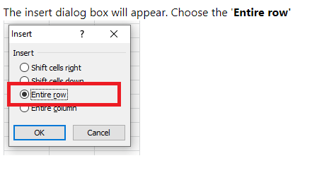

Slide 38
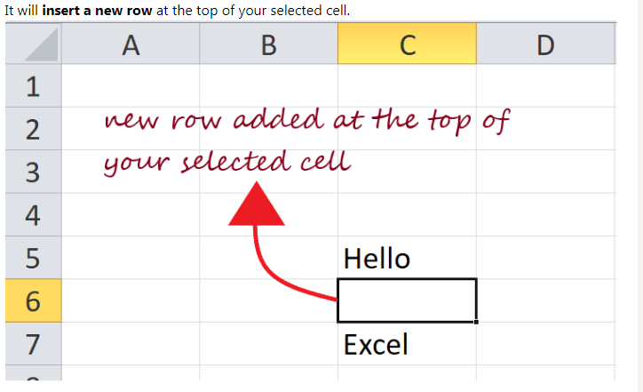

Slide 39
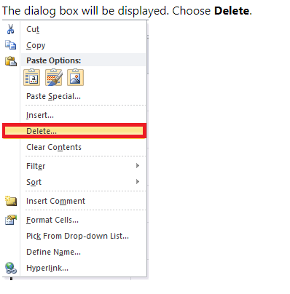
Deleting a row

Slide 40
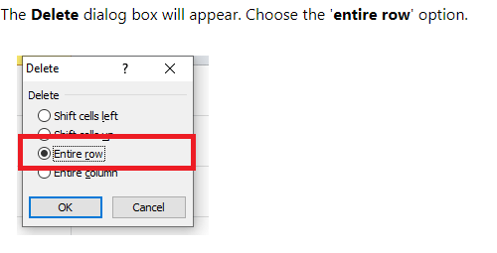

Slide 41
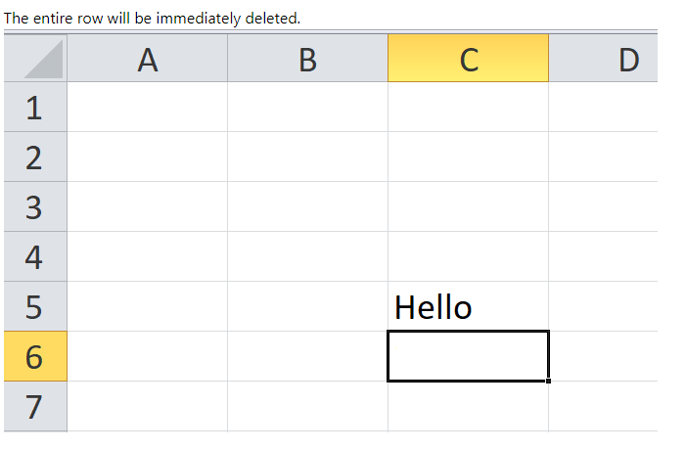

Slide 42
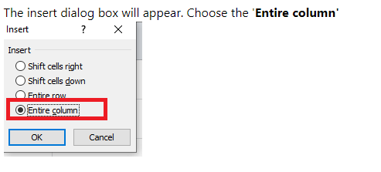
Insert a Column in Excel

Slide 43
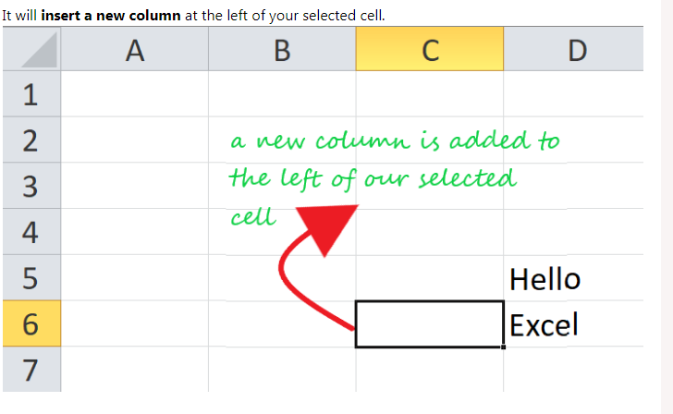

Slide 44
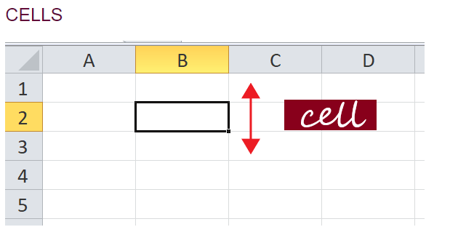
Cells

Slide 45
Excel provides the feature to select multiple cells at one time. A group of selected cells is collectively known as cell range.
A cell range covering B2, B3, B4, B5, B6, B7, B8, B9, and B10 would be addressed as B1:B10.
Cell Range: B1: B10

Slide 46
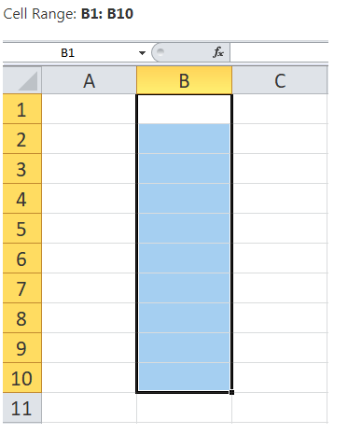

Slide 47
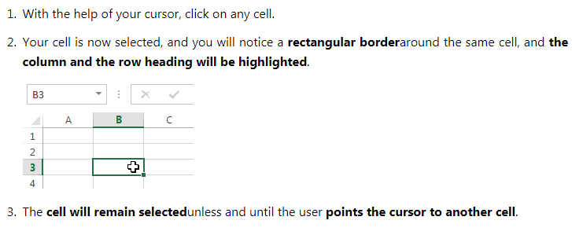
Select a cell

Slide 48
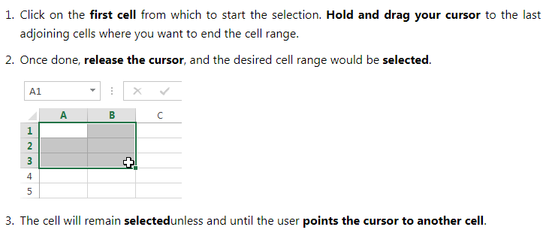
Select cell range

Slide 49
Insert content to a cell
Click and select the cellwhere you want to insert the content.
Type in the desired data into the selected cell, then click the enter button or move your cursor to another cell. The content will be shown in the cell and the formula bar.

Slide 50
Delete cell content
Click and select the cell.
To delete the cell content, press the Delete or Backspace key from your keyboard.
If you want to delete multiple cells, select the cell range and press the Delete key

Slide 51
Delete cell(s)
Click and select the cell(s).
Right-click on the cell. The dialog box will be displayed. Choose Delete.
The Delete dialog box will occur. Choose the 'entire row' option.
The cell will be immediately deleted and the cells lying below will shift up.

Slide 52
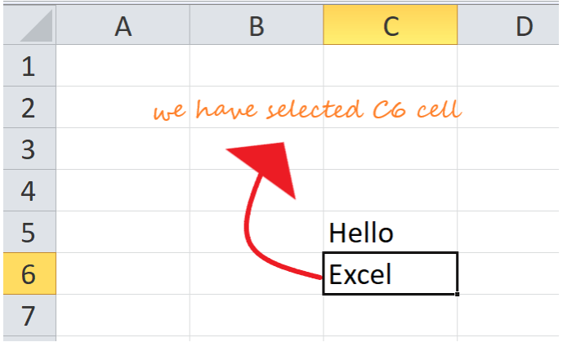

Slide 53
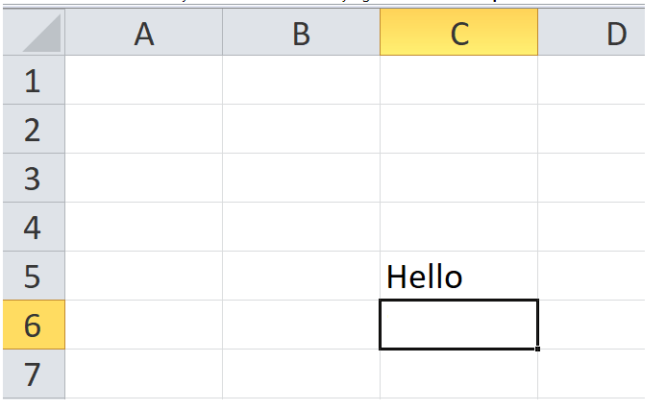

Slide 54
Drag and drop cells
Instead of copying and pasting the data, you can
use the drag and drop option to move cell
content from one cell to another.
Click and select the cell(s).
Point your cursor over the border of the selected cell(s) till it changes to a black cross with four arrows.

Slide 55
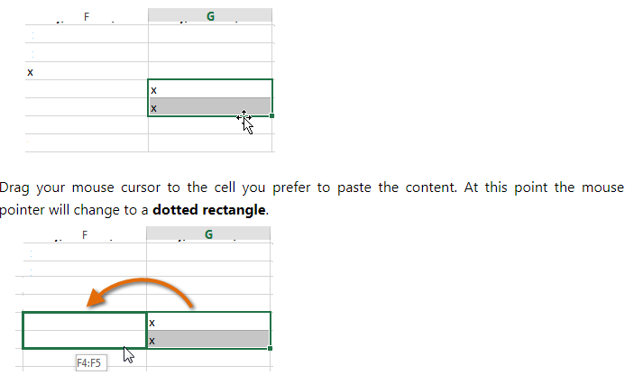

Slide 56
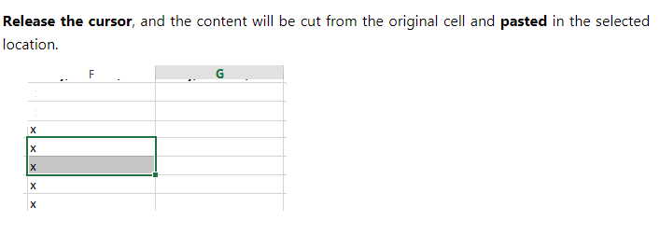

Slide 57
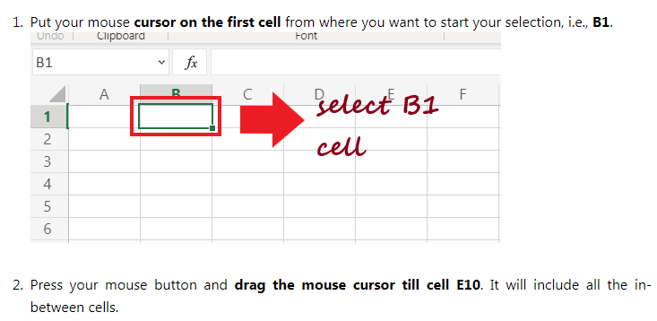
Select Multiple Continuous Cells

Slide 58
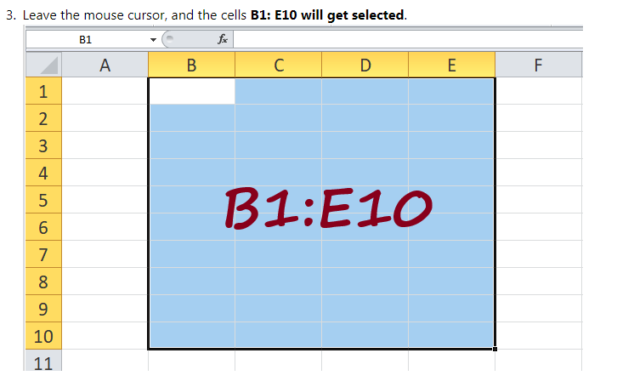

Slide 59
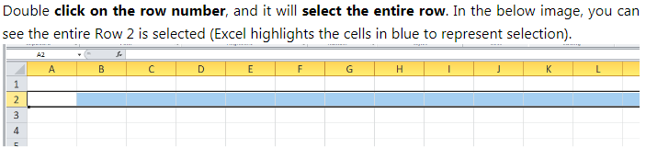
Select a Single Row/single column

Slide 60
Select Multiple Contiguous Rows/Columns
For example, suppose that you want to select row numbers 5, 6, and 7 together.
Bring your mouse cursor over row number 5 in the Excel worksheet.
Double click the left cursor to select Row 5, but keep the mouse left button pressed as we have to select multiple rows.

Slide 61
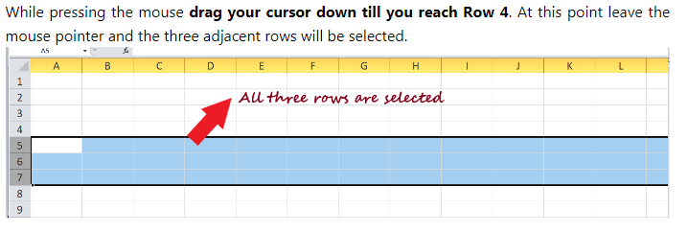

Slide 62
Select Multiple Non-Adjacent Rows/Columns
Not always, we work with contiguous Rows/Columns. We may require it to work with non-adjacent rows/columns as well.
To select random cells, rows, or columns in Excel, we have to use a keyboard and mouse combination.

Slide 63
Select the Cells in the Excel Table
With the help of Excel keyboard shortcuts, selecting the table cells of the worksheet can be done in a blink of time.
Press Ctrl+A will select all cells in one go

Slide 64
Select Cells Using Name Box
whenever you type any cell address in the name box, it selects all the mentioned cells or cell range.“
Let's suppose we have to select multiple non-contiguous cells, unlike B12, N43, and Z50.
Click on the namebox. Types in the cell address that you want to select. Separate the cell references with a comma in case you want to select multiple cells. For example, in our case, we will type in B12, N43, Z50. Press Enter button

